Slide 1
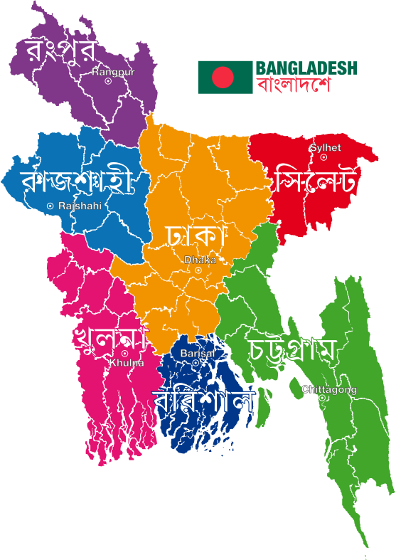

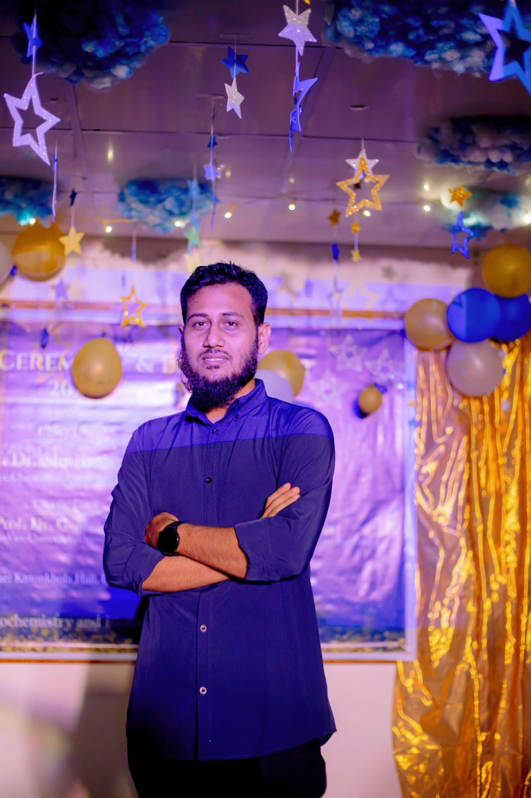
Culture of Bangladesh
Submitted To Dr. Rahat Hossain Faisal Associate Professor University of Barishal
Submitted By Jakibul Islam University of Barishal

Slide 2


It is manifested in various forms, including music, dance and drama; arts and crafts; folklore and folktales; literature, philosophy, fairs and festivals as well as in a distinct cuisine and culinary tradition. The indigenous communities of Bangladesh have their own culture and tradition full of colorful diversity.

Slide 3
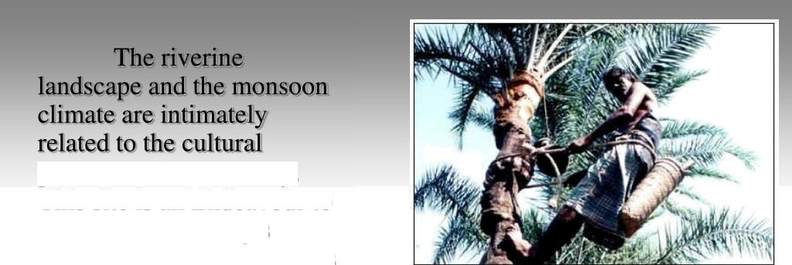
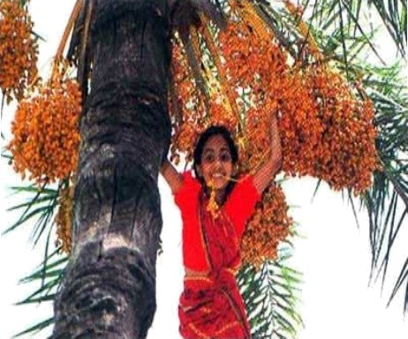
practices of this country. This site is an Endeavour to focus on the country's noteworthy cultural features including ie lifestyles and culture of the indigenous people. This site has been structured to highlight six major areas of the country's cultural aspects in a simple manner for convenience of ie tourists of both home and abroad while they prepare their itineraries to explore this country.

Slide 4

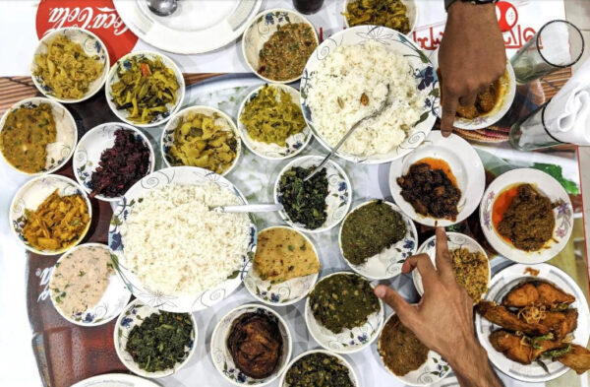
Bangladeshis
eat Bhat (boiled rice)
as their staple food and major intake; about 70 percent of what they eat is based on rice, which is their main source of carbohydrate, though health conscious people take rooti or chapati (wheat—based carbohydrate).

Slide 5
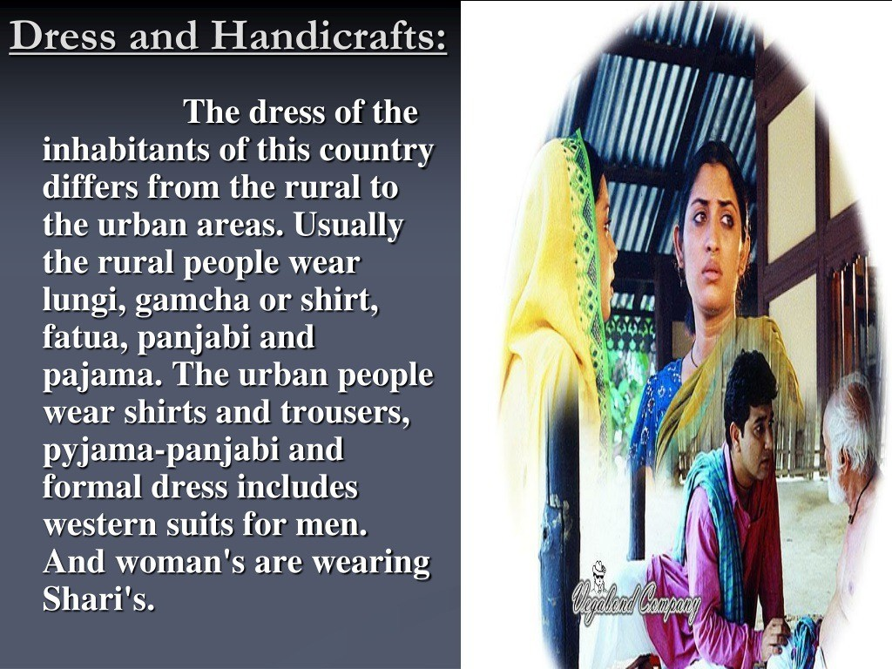

Slide 6
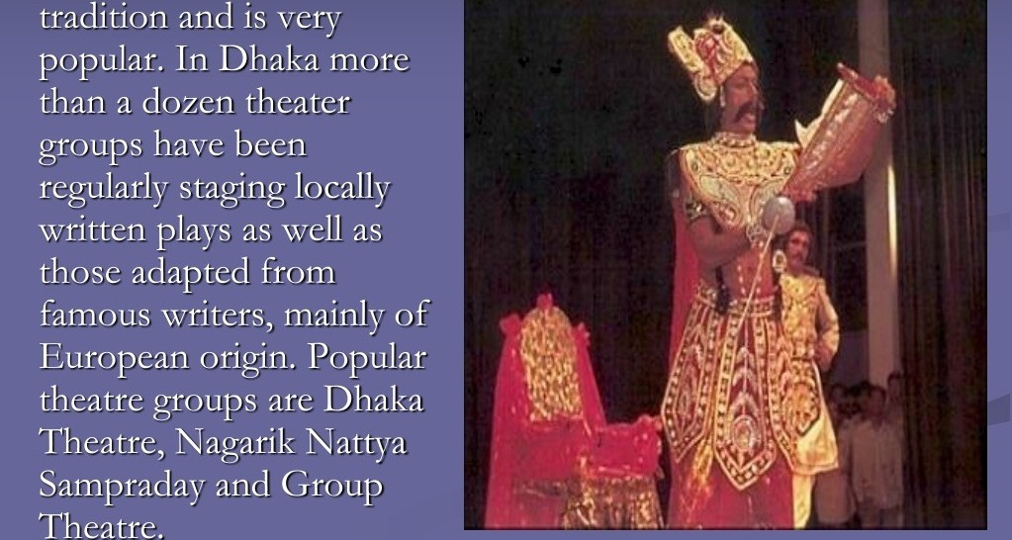
Drama in
Bangladesh has an old

Slide 7
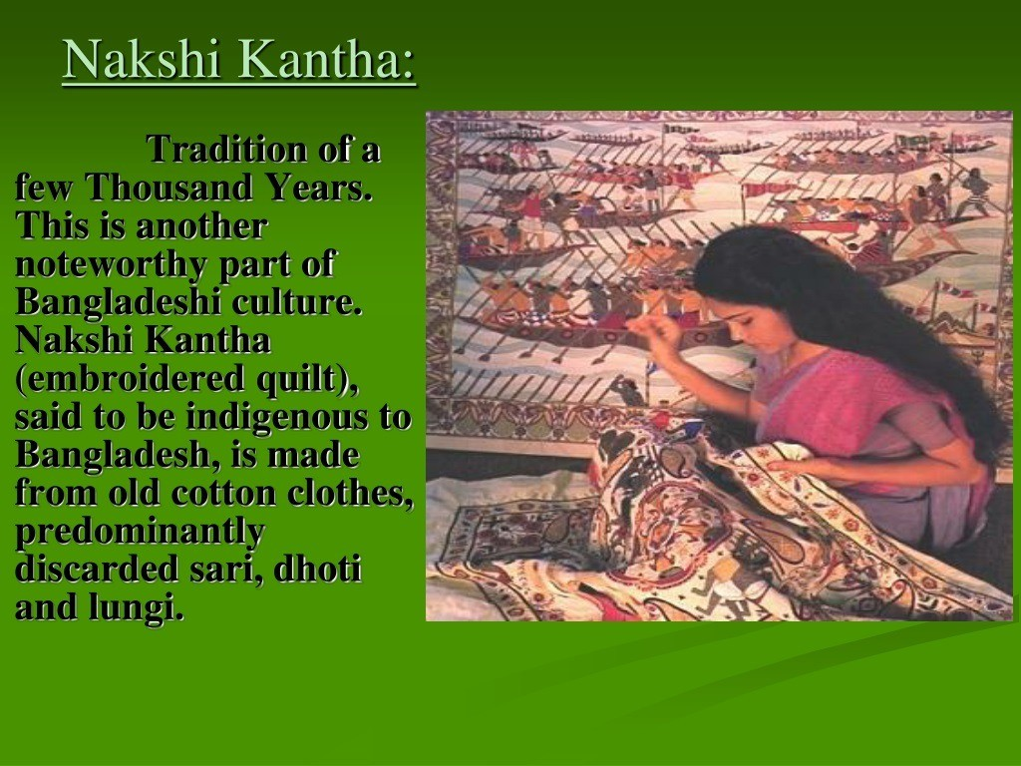

Slide 8
Festivals of Bangladesh
*Rhamdan

Slide 9


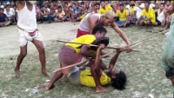
Cultural Games:

Slide 10


